Slide 1
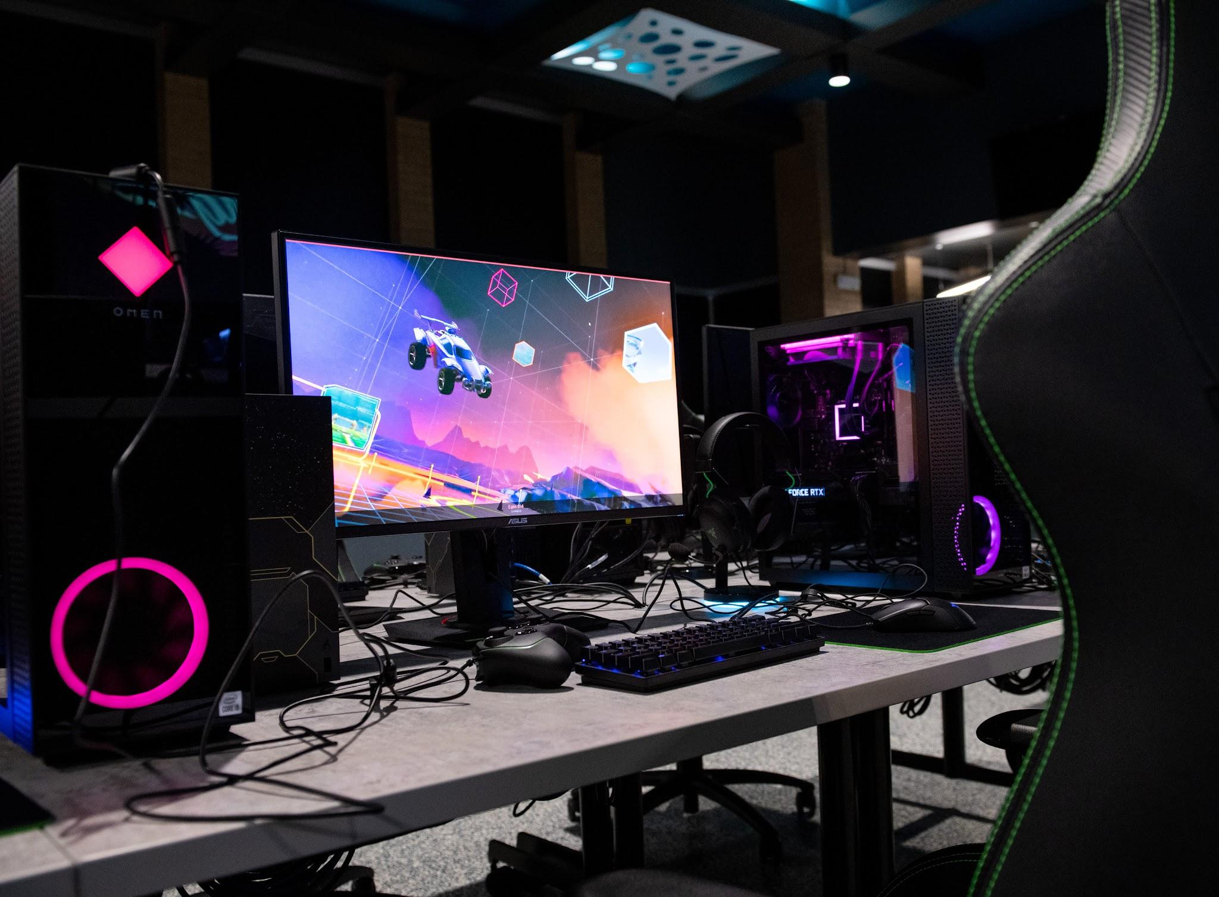
How to Build a Gaming PC
Jan Carriere

Slide 2
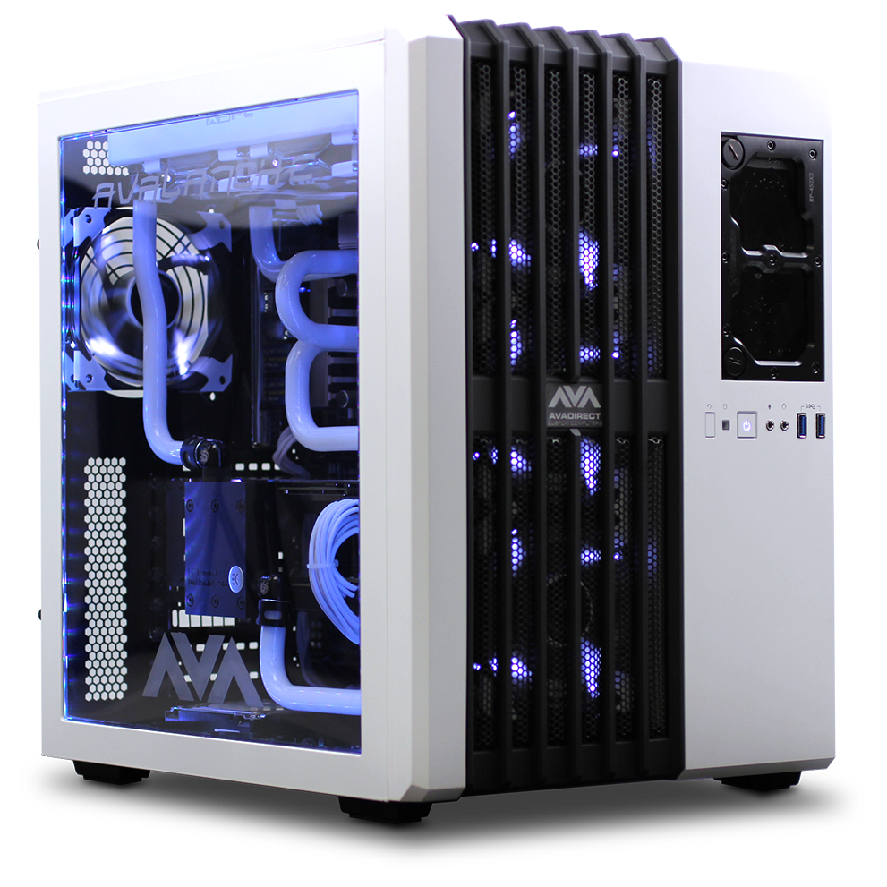
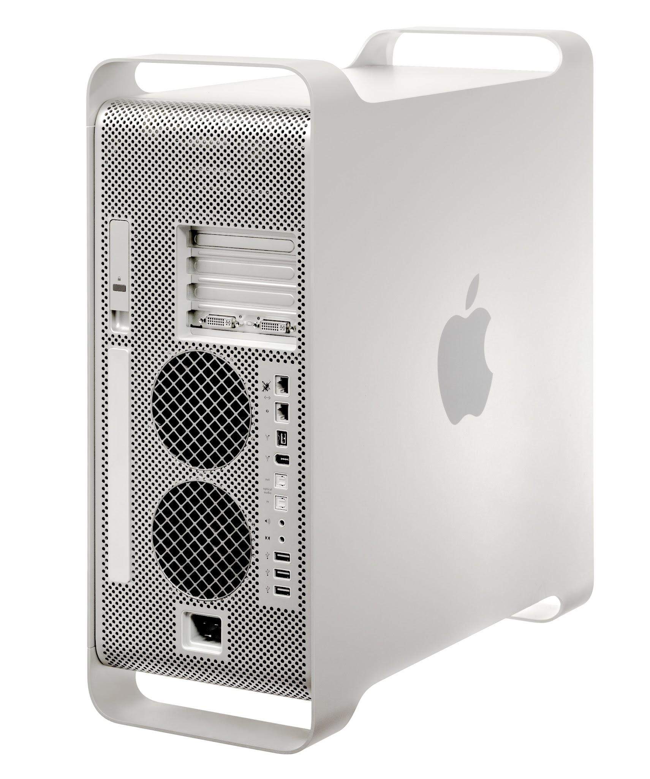
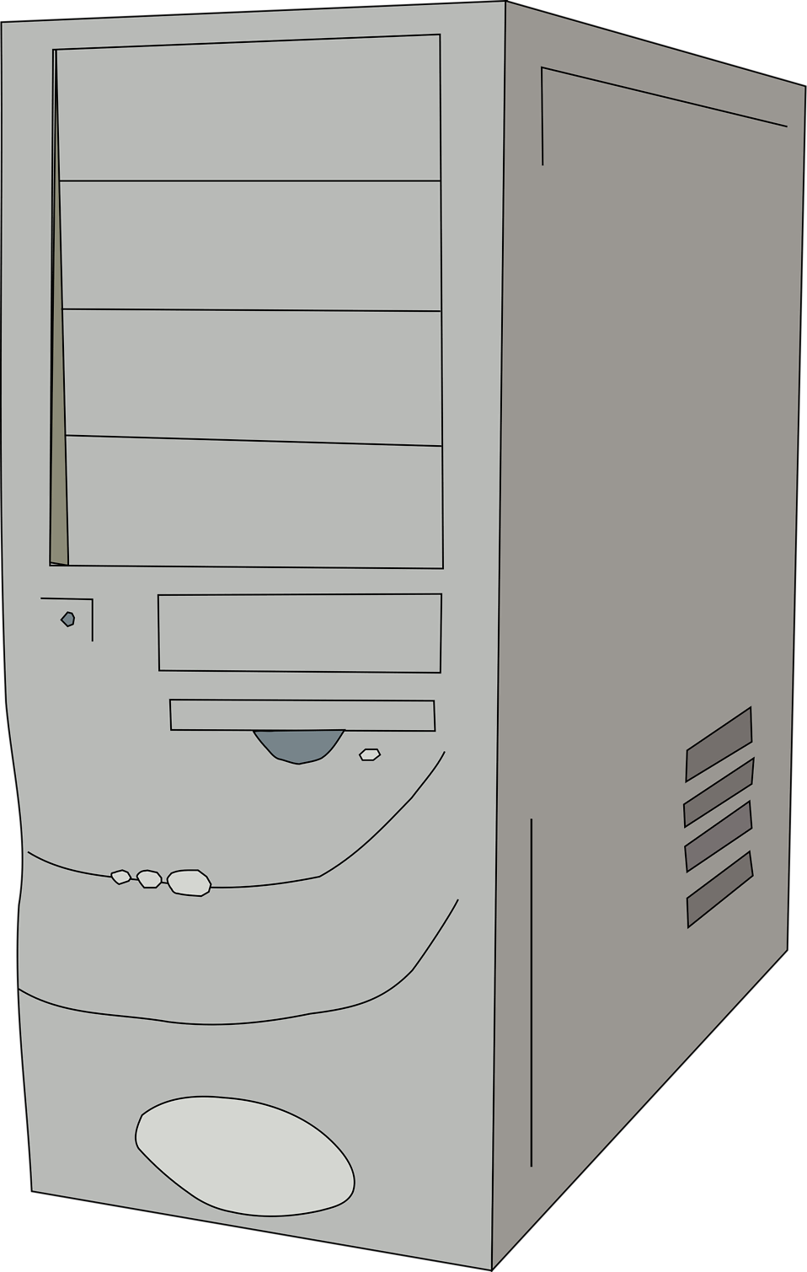
Choosing A Case

Slide 3
The Case
Every computer starts with a case. When looking for a Case it is best to take into consideration how many fans the case can hold to help with airflow and temperature management within the case. Most PC Cases now have good airflow however there are still some Companies Build a case solely for aesthetics and looks and not for performance.

Slide 4
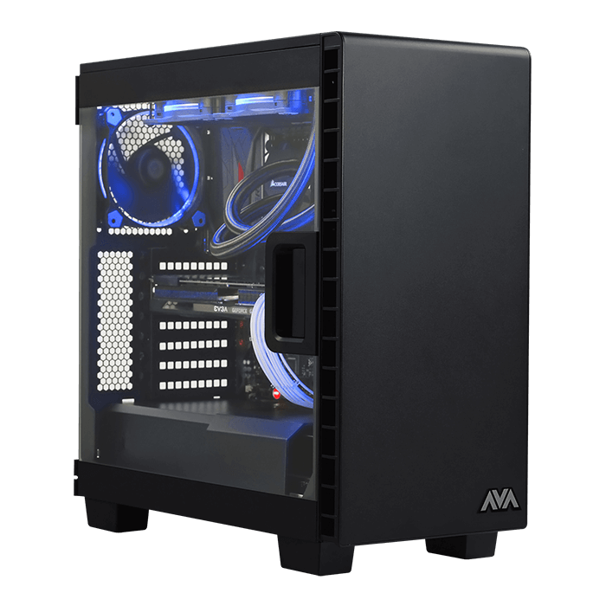
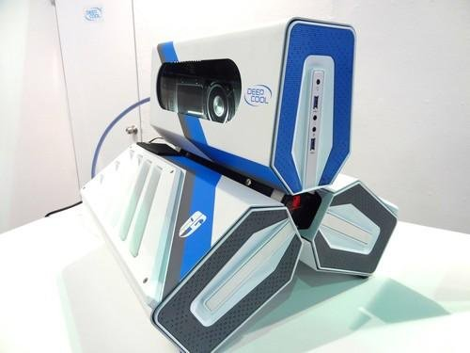
Utility over looks
While the Case on the left may look unique it does not have proper airflow and could be prone to overheating with extended use while the case on the right has a build that will allow cool air to flow in and the hot air generated to go out

Slide 5
Choosing A Power Supply
A Power supply, as the name implies, powers your computer and is what connects all the components together. Each part will require different amounts of power and usually when buying the part it will tell you the recommended wattage for each parts. If not usually in the manuals of the components have a section detailing the power consumptions. Personally i prefer modular power supplies as they allow for less clutter with the chords and make for easier cable management. Most basic gaming computers will usually require a minimum of 600w power supply. However it is never a bad idea to get a supply with more than the required power as it will draw less power if the system is not using all of the wattage.

Slide 6
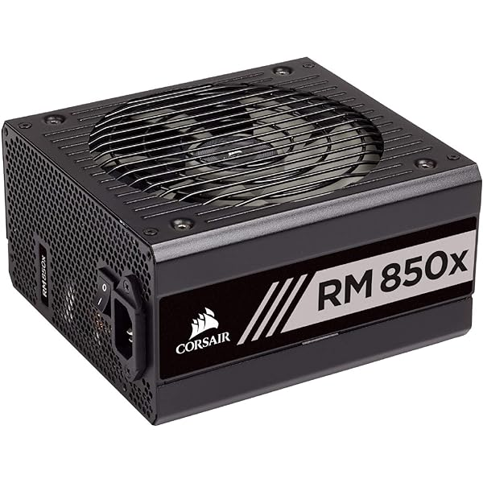
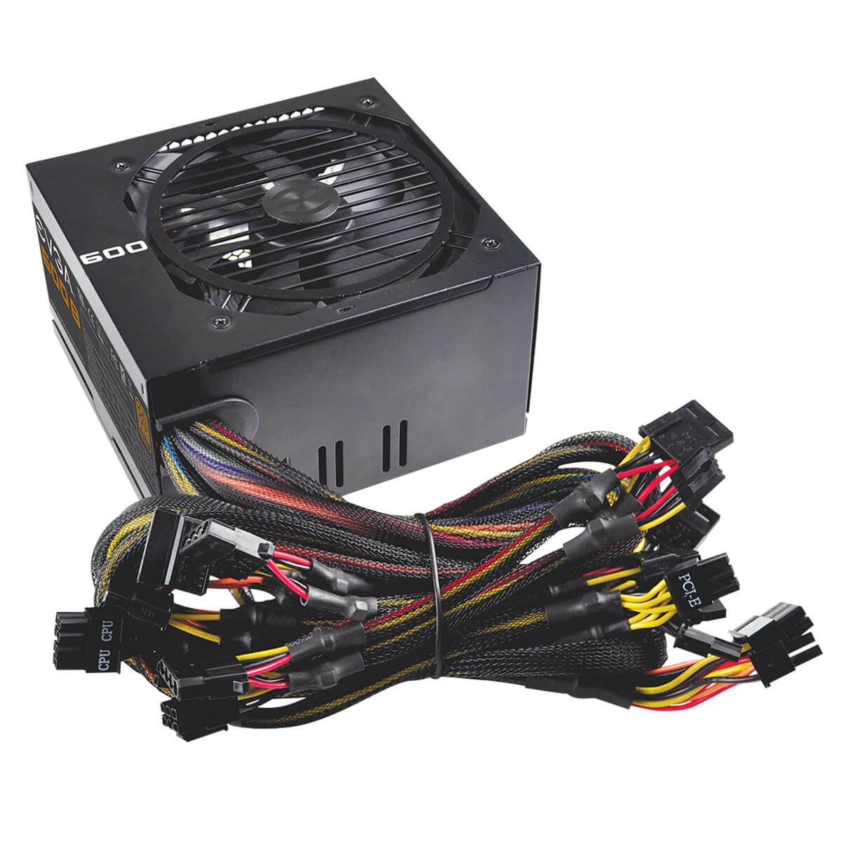
Popular power supplies
Personally the best Power Supplies are being produced by Corsair, however anything that is Gold rated 80 is a good choice
Modular Power Supply
Non Modular Power Supply

Slide 7
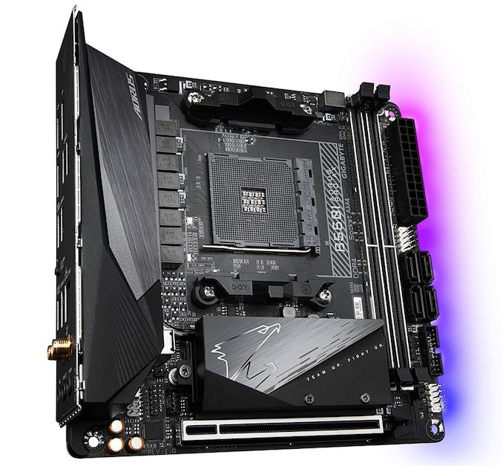
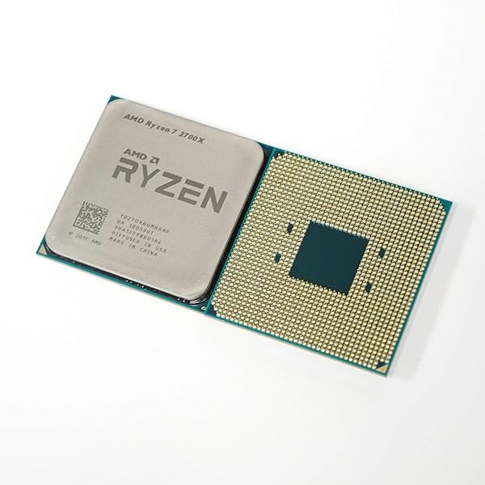
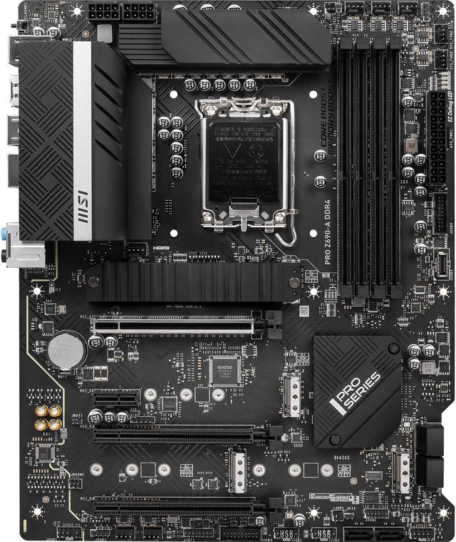
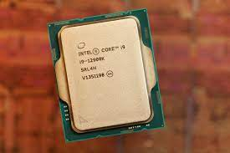
Motherboards and CPU
Motherboards and CPUs go hand in hand. When picking out either they need to make sure they are compatible with one another. If you buy a intel motherboard and then have a ryzen CPU it will not fit and vise versa.
Intel MB
AMD MB
Ryzen CPU
Intel CPU

Slide 8
CPU Cooler
There are 3 Options to cooling a CPU.
Liquid cooling is an all in one system that uses liquid and a pump to continuously pump in cool liquid onto the CPU
Fan Cooling is the traditional with a Fan attached to a Heatsink to disperse the heat
Water cooling which requires a radiator, pump and custom tubing that gives the best cooling at a premium cost.

Slide 9
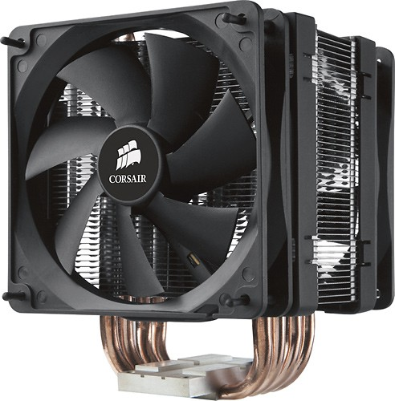
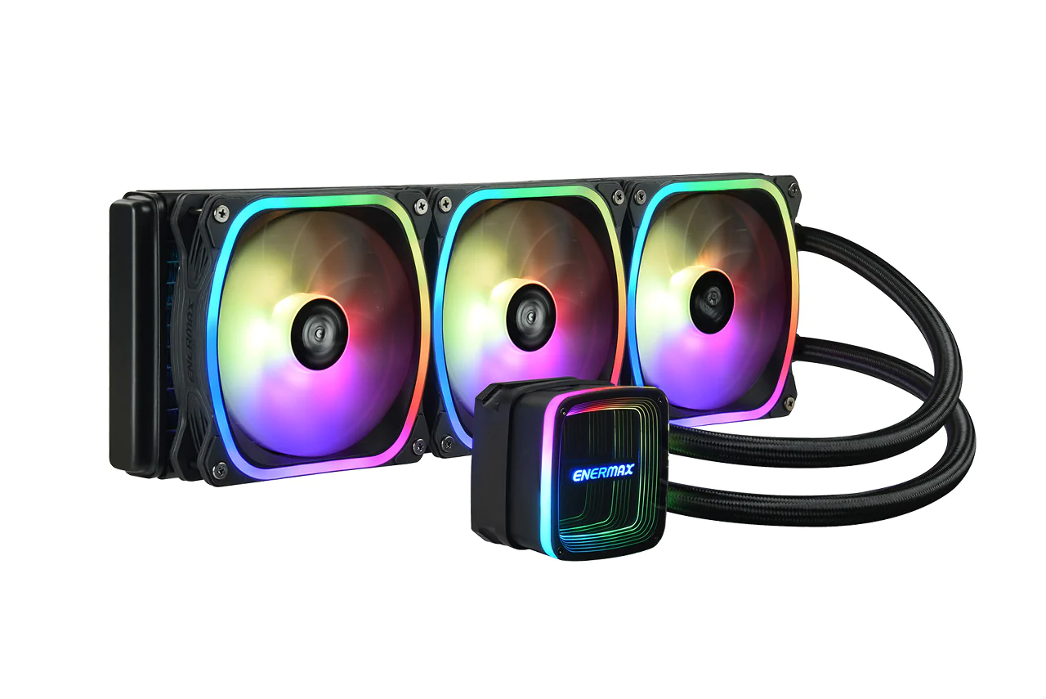
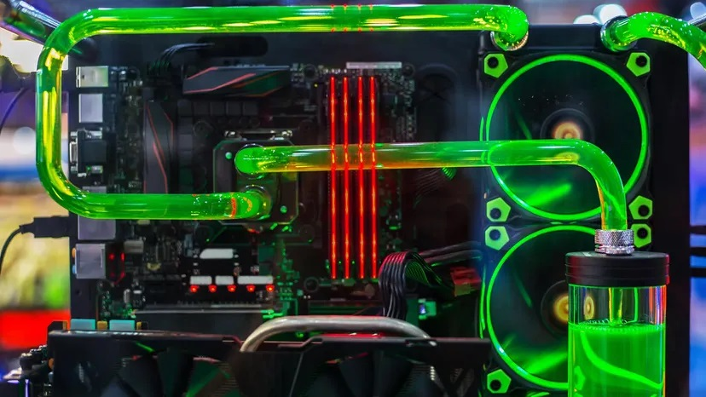
Types Of Coolers
Fan Heatsink
Liquid Cooler
Water Cooled

Slide 10
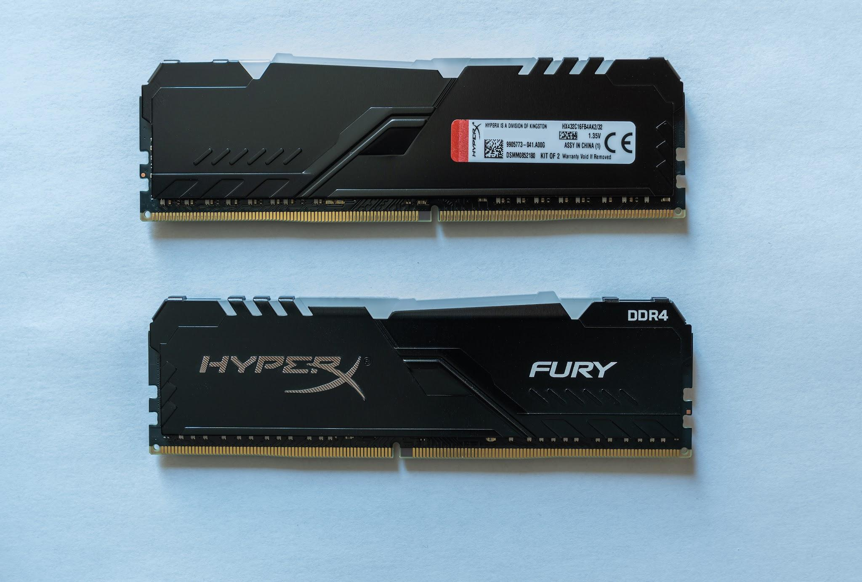
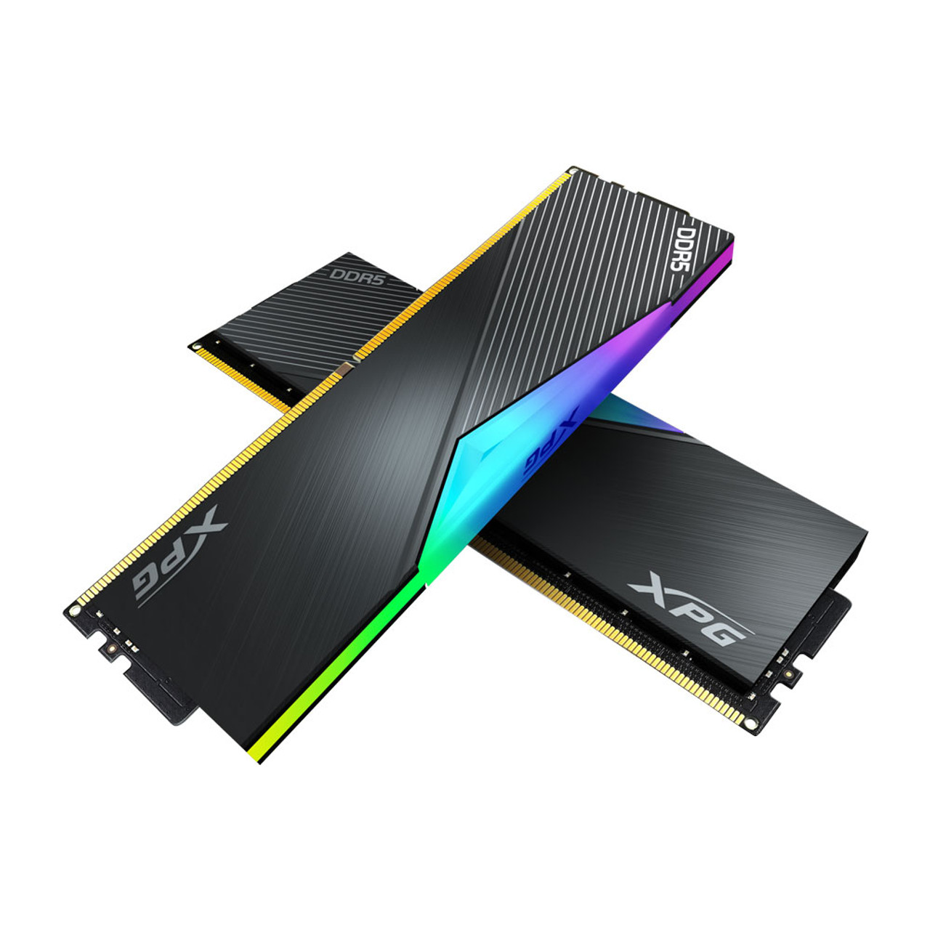
Selecting Ram
Ram is the easiest part of building a pc. All modern PCs run DDR4 ram with the occasional DDR5 With newer systems however the price for DDR5 is significantly more for the slight performance increase. Any DDR4 Ram with a 3000mhz clock speed should be perfect for everyday activities and gaming.
DDR4 Ram
DDR5 Ram

Slide 11
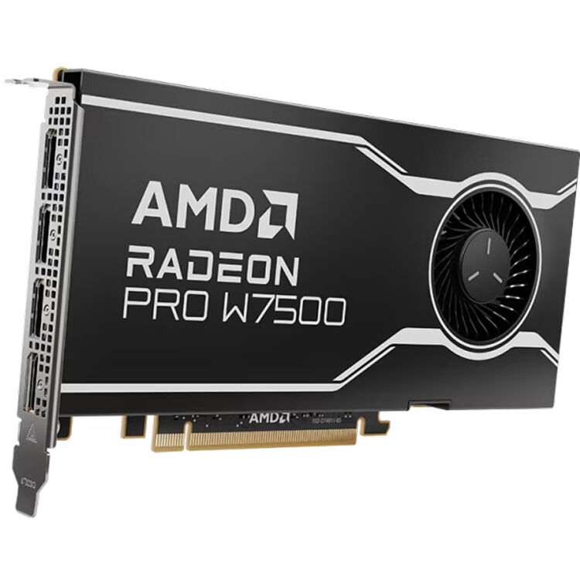
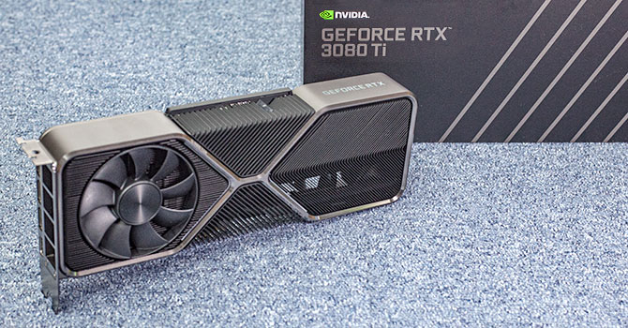
Graphics Card (GPU)
Unlike motherboards and Cpus needing to be compatible, Graphics cards can go on any board this is compatible with it meaning that AMD and Nvidia which are the primary GPUs can be put on any type of motherboard. For a while Nvidia had been controlling the GPU market however with many people from the company leaving and moving to AMD it could be said that AMD is the better choice for current GPUs.

Slide 12
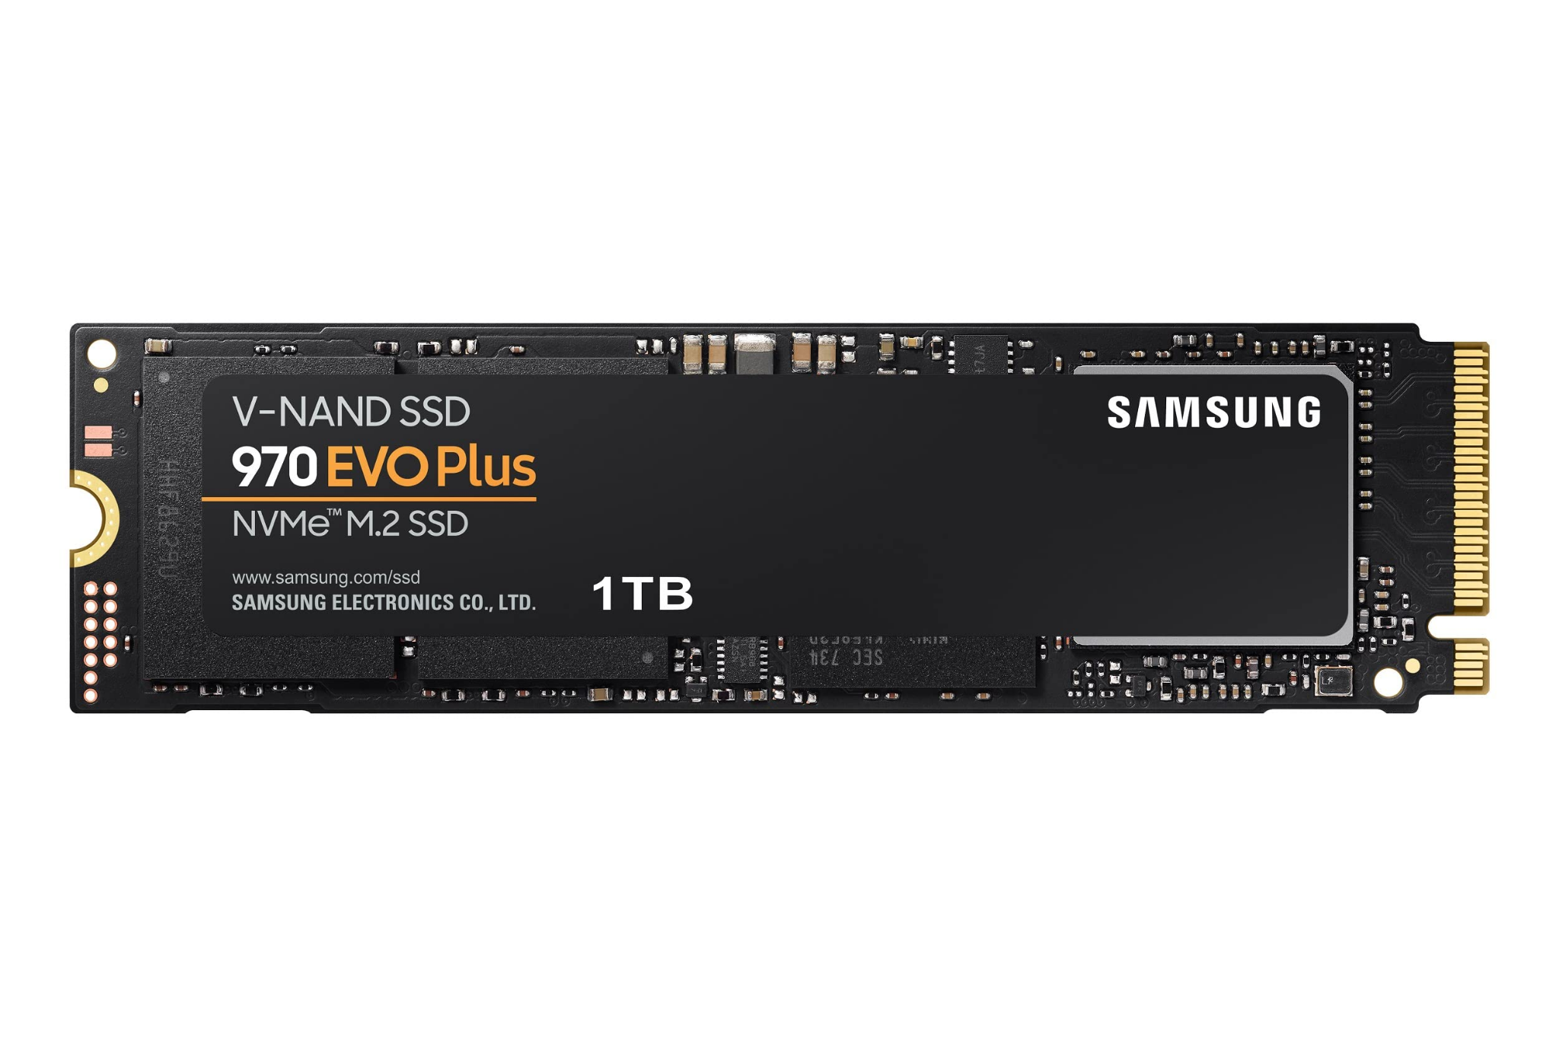
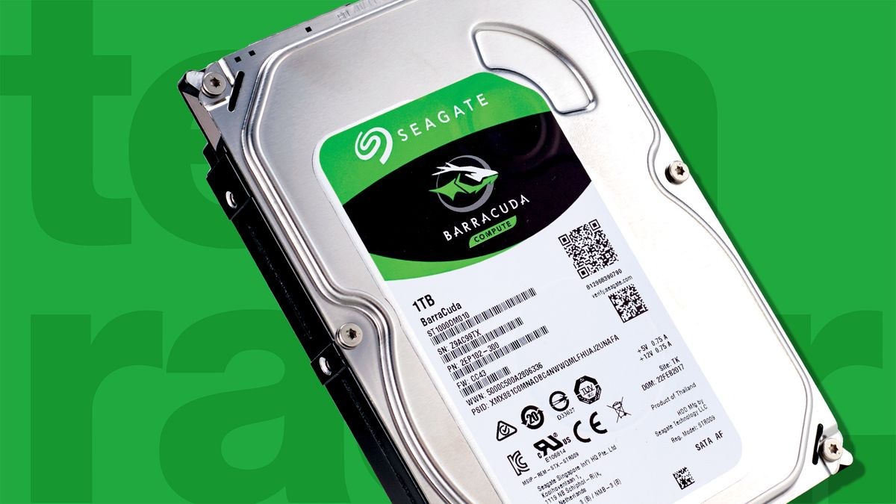
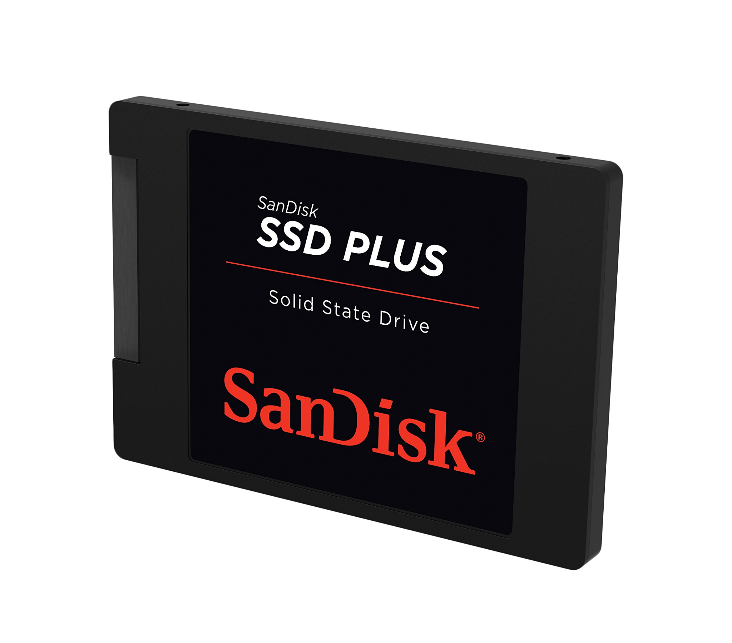
Storage
Storage is a big part of a computer it not only keeps data stored but the read and write speeds of a hard drive can change the boot times of operating systems and games alike. The popular storage has become SSD providing higher speeds, but M.2 SSDs have been increasing in popularity due to its compact nature and high read and write speeds.
Regular Hard Drive
SSD
M.2 SSD

Slide 13
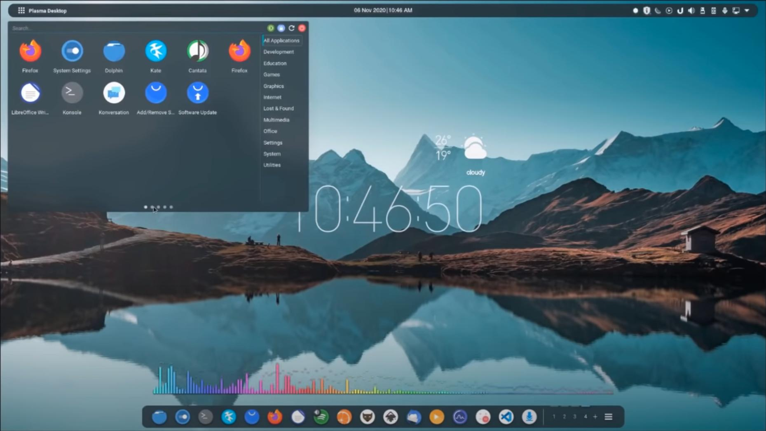
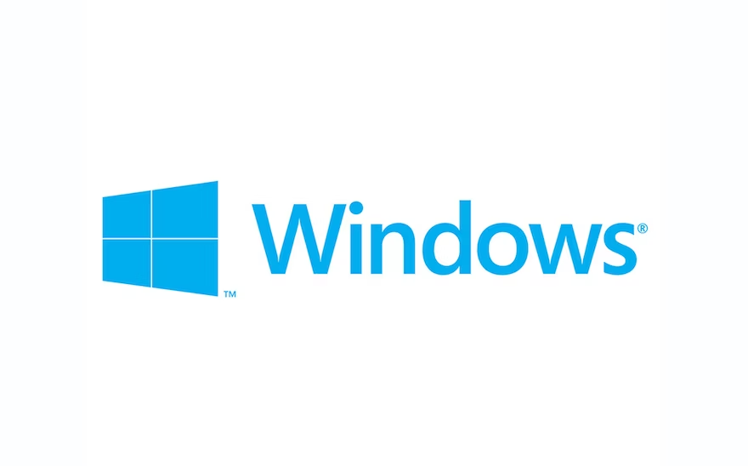
Operating System
The best recommended Operating System when building your own computer would be windows, it's easy install and accessibility make it the best OS for productivity and casual usage. Linux Could be another option or the many different variations of it however not all programs support Linux.

